Slide 1
Understanding the Landmarks
The Next Chapter
Session 3
Barb Mick - COOR ISD
Jackie Fry - COP ESD

Slide 2
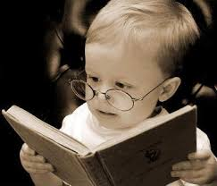
The Next Chapter
Goals for Michigan Literacy: THE NEXT CHAPTER
Understand the MLPP (Michigan Literacy Progress Profile) and improve our use of formative assessment to guide our instruction.
Improve our understanding of literacy.
Learn what is new in the research on teaching reading and writing.
Build our literacy teaching skills.

Slide 3

Goals for Session 3
Understand the newest research and thinking about comprehension.
Examine various components of comprehension and practice ways to assess those components.
Think more deeply about how the Common Core asks us to look at comprehension, especially through Close and Critical Reading.
Think together about how comprehension instruction changes over the grade levels.

Slide 4
NAEP
4th grade Reading: 30% proficient or advanced, compared to 34% nationally (Massachusetts was the highest with 48%)
8th grade Reading: 33% proficient or advanced, compared to 34% nationally (Massachusetts was again the highest with 48%)
Michigan’s scores remained “stalled” when compared to the 2011 results

Slide 5
Local Results percent proficient on 2013-14 MEAP
 | 4th | 8th
CASD | 66% | 82%
Fairview | 73% | 84%
HLCS | 59% | 63%
Mio | 65% | 67%
RAPS | 72% | 84%
WBRC | 70% | 80%
CHA | 60% | 56%

Slide 6

Legislation Proposed
House Bill 5111 would require any student who did not score “proficient” or above in reading on our state’s standardized test to be retained.
There are no provisions in the bill to address special education students or English Language Learners.
If passed as is, that would mean 36,000 students across our state would be held back.

Slide 7
Remember…
Keep the main thing the main thing!
It’s all about making meaning.

Slide 8

Quick Write…
What questions do you have going into tonight’s session?

Slide 9

Your Turn…
Bring out your case study files.
Share the assignment from Session 2 with your table (Reading Log, running record, and class engagement survey).
What did you learn about your case study students?
What surprised you?
How does this information fit with the picture you are forming of each student as a reader & writer?
What are the points of strength for each student?
What teaching points and goals do you have for each student?

Slide 10
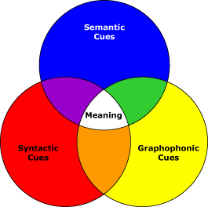
3 Cueing Systems
Story sense
Text
Illustrations
Prior Knowledge
Meaning
Print conventions
Directionality
Words/spaces
Letters
Beginnings/Endings
Punctuation
Grammatical
Patterns & Language
Structures
Knowledge of
English
Structure
Visual
Analogies
Natural
Language
Sounds and Symbols

Slide 11
Analyzing the Cueing Systems
 | Meaning (Semantic) | Structure (Syntactic) | Visual (Graphaphonic)
What is it? | Does it make sense? ­making sense of text and relaying meaningful connections ­context clues found in the text and/or background knowledge (comes from the student’s own experiences) | Does it sound right? ­making sense of the actual words in the sentences ­structural cues come from the student’s knowledge of correct oral language structures ­the way in which language is put together into sentences, phrases, paragraphs, etc. | Does it look right? ­breaking words down into letters, sounds, syllables, prefixes, chunks, etc. ­visual cues come from student's developing knowledge of letter/sound relationships and of how letters are formed ­what letters and words look like ­often identified as sounding out words

Slide 12
What Are the Teaching Points?
 | Meaning (Semantic) | Structure (Syntactic) | Visual (Graphophonic)
Instructional Ideas | Teachers need to teach genres, or nature of text forms, purpose for reading, does the word fit, what information do the illustrations provide and what has happened so far. ­ vocabulary lists ­ oral predicting ­ story line prompts ­ prior knowledge ­ pictures ­ connections ­ webs ­ graphic organizers ­ context clues, pictures, text ­ reading the room ­ “how to choose a book” ­ KWL | Teaching suggestions are to model more complex sentence structures and sentence reconstruction with familiar stories. Behaviors that capitalize on structure; - reading ahead, and re­ reading ­cut up sentences ­guess the covered word ­natural language ­knowledge of English | Do the sounds and the words I am reading match the words on the page (phonological awareness cueing system) ­ making big words ­ month by month phonics ­ word sorts ­ word analogies ­ sounds and symbols ­ capitalization ­ punctuation ­ directionality ­ word and spaces ­ beginnings and endings ­ word families ­ root words ­ syllables

Slide 13
Miscue Analysis
Which of the cueing systems is the student using?
Do a running record if you are not sure!
Older students that struggle usually are over-dependent on phonics (visual); teach them to utilize a variety of systems.

Slide 14

The 7 Comprehension Strategies
Making Connections
Questioning
Visualizing
Inferring
Determining Importance
Synthesizing
Repair understanding
Notes:
We all know these. The important thing to remember is to make sure we are using them as tools in the whole. Model them, Notice & Name them, use mentor text to illustrate how to use them, TALK about how they use them to crack the deeper meaning…

Slide 15

4 Questions About Text
What does the text SAY?
How does the AUTHOR say it?
What does it MEAN?
So what? What does it mean to ME?

Slide 16
Again…Serravallo
Guided Reading
Same book
Instructional level
Structure: book, intro, reading, teach
Why? Support with level
A - K
Strategy Lesson
Different books (everyone brings their choice)
Independent level
Structure: strategy, kids practice while teacher coaches, link
Why? Teach a strategy
G and Up
Notes:
Guided reading stops at level K. Overlap in the middle. The method matches the purpose.

Slide 17

What are the “Experts” Saying About Close Reading and Comprehension Instruction?
Number off 1-7 around the room until everyone has a number.
You will have 7 minutes to read the blog post with your number. Be sure to annotate your text.
When the timer goes off, you will find the other people with your number and you will talk about your blog post. You will have 5 minutes to discuss.
Next, your group will summarize your blog in no more than 10 words. What message did you take from this reading?
Finally, come up with ONE compelling question you still have. Write your question on the chart paper at the front of the room. You will have 10 minutes to complete your summary and develop your question.
Be ready to read your summary to the group.

Slide 18

Text Complexity
The CCSS requires greater rigor and more complex text.
Nobody is saying that students in the primary grades should read harder text; we do expect that we are reading harder text TO them. By 2nd grade, students should be doing the reading.
We want students of all ages digging into complex text, thinking deeply about that text, and finding the evidence for their thinking in that text.
We have to understand what makes the text hard. Those “hard parts” become our teaching points.
Notes:
Doug Fisher

Slide 19
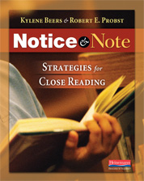
Text Complexity Rubric
from Notice & Note (Beers & Probst, 2013)
Notes:
Doug Fisher has created one; Ellin Keene and Bob Probst also have one (simpler)

Slide 20
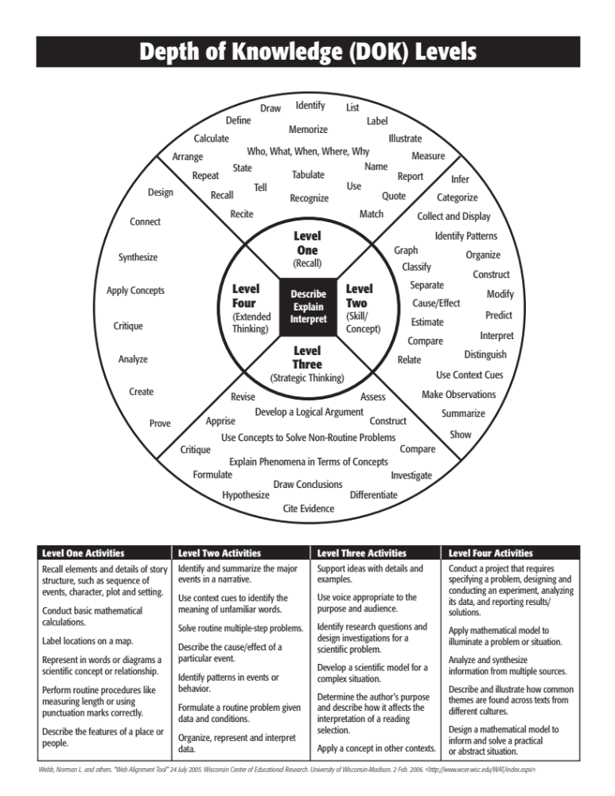
Notes:
Where does RETELLING fall? What about SUMMARY?

Slide 21
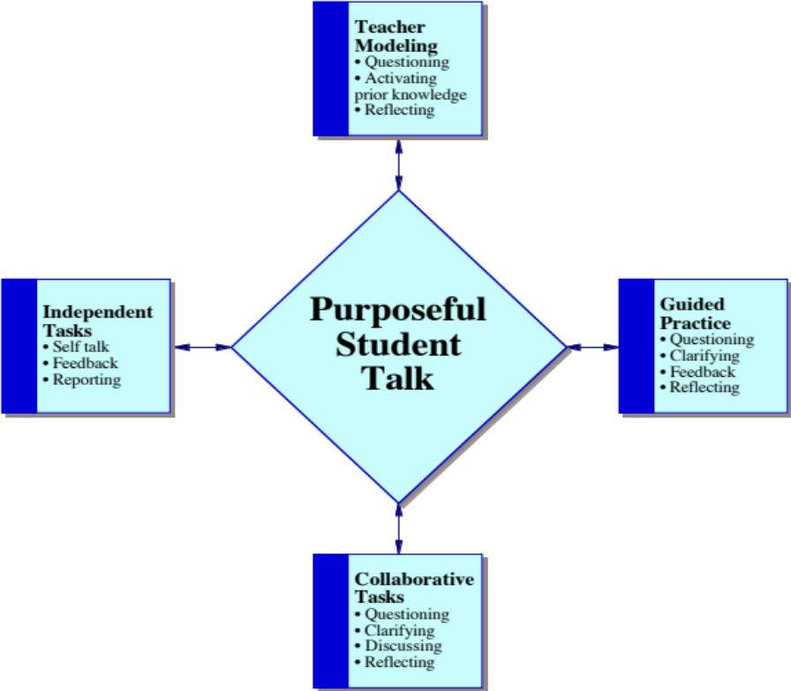
Knowing what to listen for:
Productive group work in action
How do you know productive group work when you hear it?
Notes:
Purposeful student talk, like all learning, requires a gradual release of responsibility. Doug Fisher graphic.

Slide 22
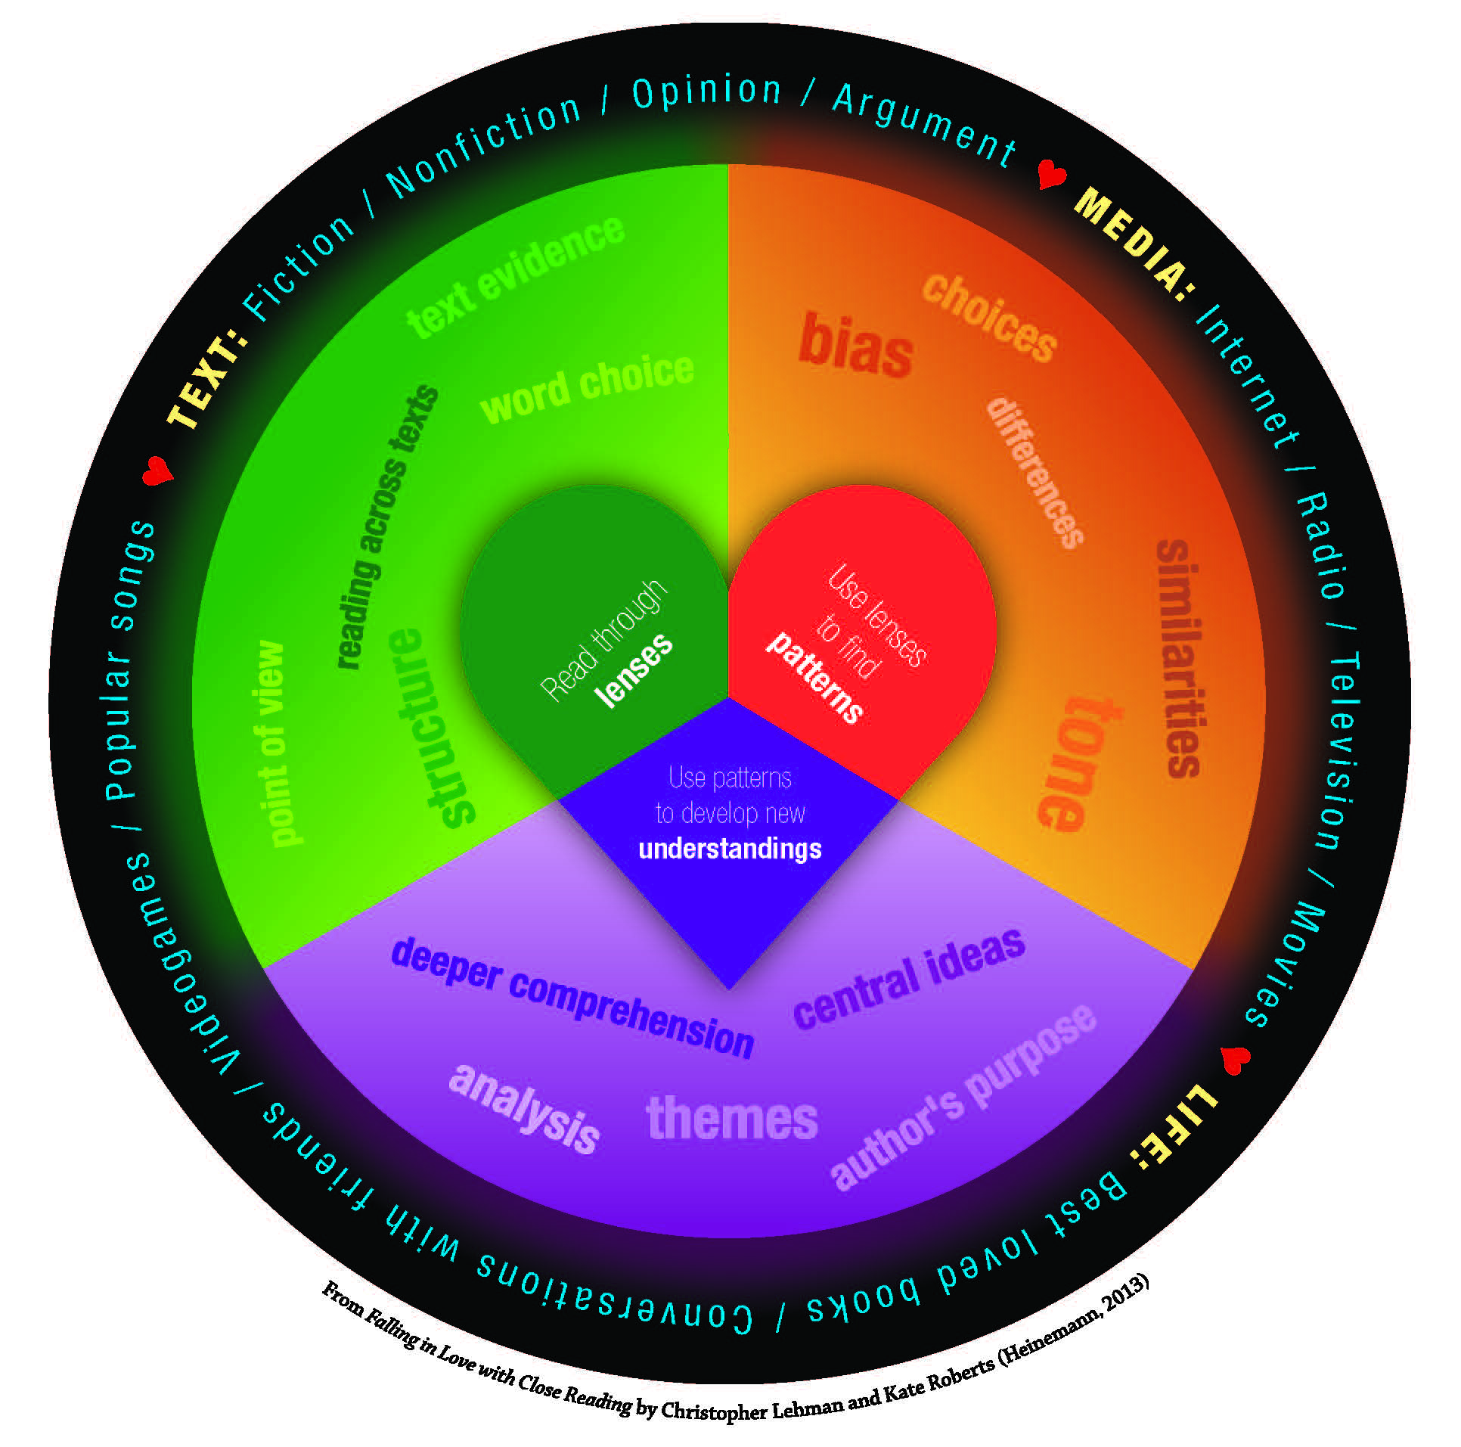
What is Close Reading?
Notes:
From Chris Lehman’s book Falling in Love with Close Reading

Slide 23

Powerful Close Reading Instruction
must raise engagement and joy, not diminish it
must lead to student independence, not dependence on teacher’s prompting
must be one piece of your reading instruction, not the only part of your instruction
must allow time for students to read for extended periods and across many pages of text, not interrupt time spent reading with activities
must be repeated across time and involve lots of opportunities for practice, not be a one-time, off-the-checklist activity
must be designed in response to the strengths and needs of your students, not planned solely to match a book or fit a scope and sequence
Notes:
Chris Lehman

Slide 24
What is Close Reading?
It is an interaction between the reader and a text (Douglas Fisher in the online video interview, “Close Reading and the Common Core Standards,” April 3, 2012)
It is about making careful observations of a text and then interpretations of those observations (Patricia Kain for the Writing Center at Harvard University, 1998)
It involves rereading; often rereading a short portion of a text that helps a reader to carry new ideas to the whole text (Kylene Beers and Robert Probst in Notice and Note, 2012)
Notes:
Chris Lehman

Slide 25

Creating a Close Reading
“We will be reading this text multiple times.” Doug Fisher
Use a short passage.
Read with a pencil. (Teach them to annotate…even our youngest students…sticky notes.)
Note what’s confusing.
Pay attention to patterns.
Give students a chance to struggle a bit.
“Read like a detective. Write like a reporter” David Coleman

Slide 26
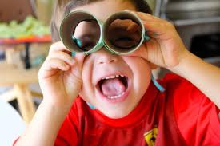
Creating a Close Reading
Understanding at a deep level what the author intends is critical before you can make a personal connection.
You choose a piece of text, figure out what makes it hard, then design your lesson around this list.
In a close reading, we avoid frontloading and pre-teaching vocabulary.
Close reading is a type of guided instruction (“We do it” on the GRR)
Plan to read the text 4, 5, 6 times…if you don’t need to do this, your questions aren’t deep enough.
Students do a “cold” reading first. Tell them, “I know this is hard. It’s okay; we’re going to read it again and again to get it.”
In the early grades, the first read is a read-aloud.
Notes:
Doug Fisher

Slide 27

How to Do a Close Reading
First, read through lenses: Decide what you will be paying attention to while reading and collect those details.
Next, use lenses to find patterns: Look across all of the details you have collected and find patterns. As Dorothy Barnhouse and Vicki Vinton discuss in What Readers Really Do (2012), details alone do not mean much until you begin to see relationships across them.
Finally, use the patterns to develop a new understanding of the text: Consider these patterns in light of what you have already learned from the text. Put these together to develop a new understanding of the text or a deeper, evidence-based interpretation.

Slide 28
Reading Closely for Text Evidence
Read through lenses. | Choose specific details to gather as data: What characters/people say/think/do Relationships Setting descriptions Time period
2. Use lenses to find patterns. | What details fit together? How do they fit together?
3. Use the patterns to develop a new understanding of the text. | Look at patterns to think about: Character’s/people’s - feelings - traits - relationships Whole text: - themes - lessons
Notes:
Chris Lehman

Slide 29

Text Dependent Questions
Do the questions require the reader to return to the text?
Do the questions require the reader to use evidence to support his or her ideas or claims?
Do the questions move from text-explicit to text-implicit knowledge?
Are there questions that require the reader to analyze, evaluate, and create?
Notes:
Doug Fisher

Slide 30
Progression of Text Dependent Questions
Across Texts | WHOLE PART | Questions, Arguments, Inter-textual connections
Entire Texts |  | Inferences
Segments |  | Author’s Purpose
Paragraphs |  | Vocabulary & Text Structure
Sentence |  | Key Details
Word |  | General Understanding

Slide 31

General Understandings
Overall view
Sequence of information
Story Arc
Main claim and evidence
Gist of the passage
The Very Hungry Caterpillar
Retell the story in order using beginning, middle, and end.

Slide 32

Key Details
Search for nuances in meaning
Determine importance of ideas
Find supporting details that support main ideas
Answers who, what, when, where, why, how much, or how many

Slide 33
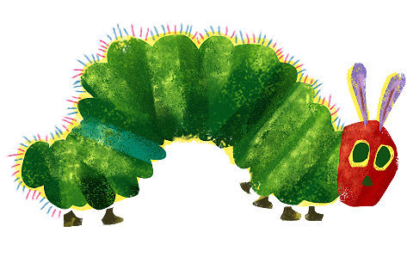
Key Details in Kindergarten
The Very Hungry Caterpillar
How long did it take to go from a hatched egg to a butterfly?
What is one food that gave him a stomachache? What is one food that did not give him a stomachache?

Slide 34

Foods that did not give him a stomachache
Foods that gave him a stomachache
Apples
Pears
Plums
Strawberries
Oranges
Green leaf
Ice cream
Pickle
Swiss cheese
Salami
Lollipop
Cherry pie
Sausage
Cupcake
Watermelon

Slide 35
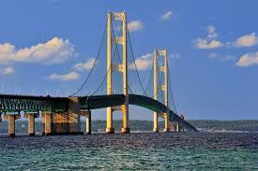
Vocabulary & Text Structure
Bridges literal and inferential meaning
Denotation
Connotation
Shades of meaning
Figurative language
How organization contributes to meaning

Slide 36

Vocabulary in Kindergarten
How does the author teach us what the word cocoon means?

Slide 37

Author’s Purpose
Genre: Entertain? Explain? Inform? Persuade?
Point of view: First-person, third-person, limited,
omniscient, unreliable narrator
Critical literacy: Whose story is NOT represented?

Slide 38
Author’s Purpose in Kindergarten
The Very Hungry Caterpillar
Who tells the story – the narrator or the caterpillar?

Slide 39
A narrator tells the story because he uses the
words he and his. If it was the caterpillar,
he would say I and my.

Slide 40
Inference
Probe each argument in persuasive text,
Each idea in informational text,
And each key idea in narrative text.
How do certain parts of the text fit together?
Inferences in Kindergarten
The title of the book is The Very Hungry Caterpillar. How do we know the caterpillar is hungry?

Slide 41
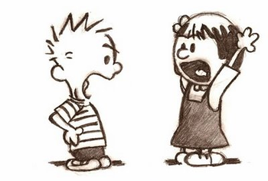
Opinions, Arguments, and Inter-textual Connections
Author’s opinion with reasoning
Claims
Evidence
Counterclaims
Ethos, pathos, logos
Rhetoric
Across texts

Slide 42

Opinion, Argument, and Intertextual Connections in Kindergarten
The Very Hungry Caterpillar
Is this a happy story or a sad one?
How do you know?
Monarch Butterfly
How are these two books similar?
How are they different?

Slide 43

What if we added one more to the mix?

Slide 44


Your Assignment
Create a Close Reading lesson; keep notes about how it went and be ready to share next time.
Complete a retelling assessment with your 3 case study students using the Retelling Rubric.
Complete a summary assessment with your 3 case study students using the Summary Rubric.
Complete the Reflection Question for session 3.

Slide 45

Ticket Out the Door & Wrap Up
Please complete your Gots/Needs reflection and turn it in as you leave.
Our next meeting will be: Consider This – Best Practice to Inform Our Planning. We will be looking more closely at comprehension and sharing more strategies.
Thank you for your hard work, thoughtful contributions, and professionalism!

